Slide 1
Virtual Functions
Notes:
Student Book

Slide 2
Motivation: Virtual Functions
a hierarchy of geometric shape classes
  draws circles, ellipses, rectangles etc
just use method draw throughout the hierarchy
Line
draw()‏
Rectangle
Circle
draw()‏
draw()‏
Square
Ellipse
draw()‏
draw()‏

Slide 3
Introduction to Virtual Functions
A virtual function is a member function that is declared within a base class and redefined (called overriding) by a derived class.
It implements the “one interface, multiple methods” philosophy that underlies polymorphism.
The keyword virtual is used to designate a member function as virtual.
Supports run-time polymorphism with the help of base class pointers.

Slide 4
Introduction to Virtual Functions (contd.)
While redefining a virtual function in a derived class, the function signature must match the original function present in the base class.
So, we call it overriding, not overloading.
When a virtual function is redefined by a derived class, the keyword virtual is not needed (but can be specified if the programmer wants).
The “virtual” of the member function continues along the inheritance chain.
A class that contains a virtual function is referred to as a polymorphic class.

Slide 5
Virtual Function
The application of polymorphism is the ability to refer the objects without any regard to their classes.
This necessitates the use of a single pointer variable to refer to the objects of different classes.

Slide 6
Virtual Function – Cont.
By making the function 'virtual' in base class C++ determines which function to use at run time based on the type of object pointed to by the base pointer , rather than the type of the pointer.
Runtime polymorphism is achieved only when a virtual function is accessed through a pointer to the base class.

Slide 7
C++ allows base class pointers to point to derived class objects.
Let we have
  class base { … };
  class derived : public base { … };
Then we can write:
  base *p1;
  derived d_obj;
  p1 = &d_obj;

Slide 8
class Base {
public:
virtual void show() {
cout << “base\n”;
}
};
class Derv1 : public base {
public:
void show() {
cout << “derived1\n”;
}
class Derv2 : public base {
public:
void show() {
cout << “derived2\n”;
}
};
void main()
{
Derv1 dv1;
Derv2 dv2;
Base *ptr
ptr = &dv1;
ptr->show();
ptr = &dv2;
ptr ->show();
return 0;
}

Slide 9
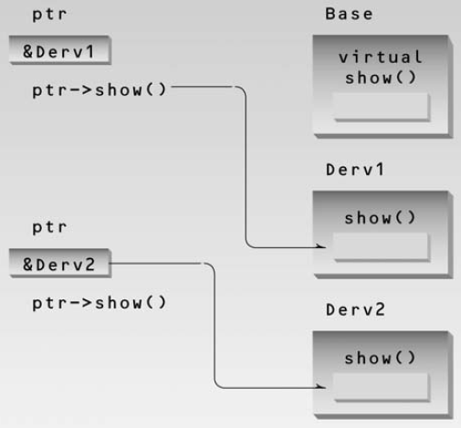
Virtual Pointer Access

Slide 10
Virtual Functions - Rules
The virtual functions must be members of some class.
They cannot be static members.
They are accessed by using object pointers.
A virtual function can be friend of other function.
A virtual function in a base class must be defined , even though it may not be used.

Slide 11
Rules –Cont.
We cannot have a virtual constructors.
While a base pointer can point to any type of derived object, the reverse is not true.

Slide 12
Rules –Cont.
The prototypes of the base class version of a virtual function and all the derived class versions must be identical.
When a base pointer points to a derived class , incrementing or decrementing it will not make it to point to the next object of the derived class.

Slide 13
Rules –Cont.
If a virtual function is define in the base class ,it need not be necessarily redefined in the derived class.

Slide 14
Dynamic Method Dispatch
Method overriding forms the basis of Java’s most powerful concepts.
It is called dynamic method dispatch.
Dynamic method dispatch is the mechanism by which a call to an overridden method.
Dynamic method dispatch is important because this is how Java implements run-time polymorphism.

Slide 15
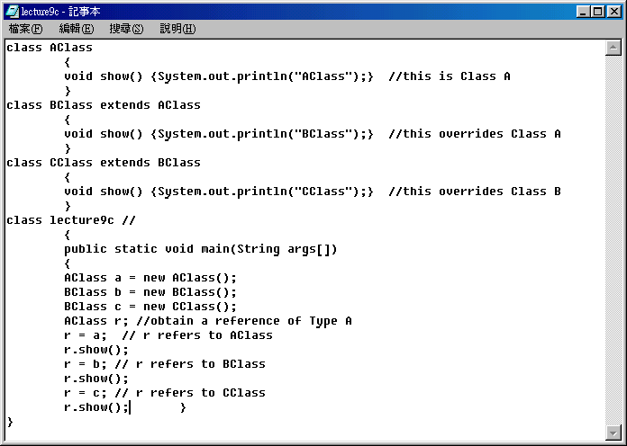

Example – dynamic dispatch

Slide 16
Abstract Classes and
Pure Virtual Functions
A base class whose objects are never instantiated is called an abstract class. Such a class exists only to act as a parent of derived classes that will be used to instantiate objects.
A base class made as an abstract class must contain at least one pure virtual function.
A pure virtual function is one with the expression “=0” added to the function declaration.
e.g.,
virtual void show() = 0;

Slide 17
Difference between virtual and pure virtual Functions
BASIS FOR
COMPARISON
VIRTUAL FUNCTION
PURE VIRTUAL FUNCTION
Base
‘virtual function’ has their definition in the base class
‘pure virtual function’ has no definition in the base class.
Declaration
Funct_name(parameter_list){….};
Virtual funct_name(parameter_list)=0;
Derived class
All derived classes may or may not override the virtual function of the base class
All derived classes must override the virtual function of the base class.

Slide 18
class Base {
public:
virtual void show() = 0;
};
class Derv1 : public base {
public:
void show() {
cout << “derived1\n”;
}
class Derv2 : public base {
public:
void show() {
cout << “derived2\n”;
}
};
void main()
{
Base bad; //ERROR
Derv1 dv1;
Derv2 dv2;
Base *ptr ;
ptr = &dv1;
ptr->show();
ptr = &dv2;
ptr ->show();
return 0;
}

Slide 19
Abstract class and Abstract Method in Java

Slide 20
Abstract methods
You can declare an object without defining it:
  Person p;
Similarly, you can declare a method without defining it:
  public abstract void draw(int size);
  Notice that the body of the method is missing
A method that has been declared but not defined is an abstract method

Slide 21
Abstract classes
Any class containing an abstract method is an abstract class
You must declare the class with the keyword abstract:
  abstract class MyClass {...}
An abstract class is incomplete
  It has “missing” method bodies
You cannot instantiate (create a new instance of) an abstract class

Slide 22
Abstract classes
You can extend (subclass) an abstract class
  If the subclass defines all the inherited abstract methods, it is “complete” and can be instantiated
  If the subclass does not define all the inherited abstract methods, it too must be abstract
You can declare a class to be abstract even if it does not contain any abstract methods
  This prevents the class from being instantiated

Slide 23
An example abstract class
public abstract class Animal {
abstract int eat();
abstract void breathe();
}
This class cannot be instantiated
Any non-abstract subclass of Animal must provide the eat() and breathe() methods

Slide 24
A problem
class Shape { ... }
class Star extends Shape {
void draw() { ... }
...
}
class Crescent extends Shape {
void draw() { ... }
...
}
Shape someShape = new Star();
  This is legal, because a Star is a Shape
someShape.draw();
  This is a syntax error, because some Shape might not have a draw() method
  Remember: A class knows its superclass, but not its subclasses

Slide 25
A solution
abstract class Shape {
abstract void draw();
}
class Star extends Shape {
void draw() { ... }
...
}
class Crescent extends Shape {
void draw() { ... }
...
}
Shape someShape = new Star();
  This is legal, because a Star is a Shape
  However, Shape someShape = new Shape(); is no longer legal
someShape.draw();
  This is legal, because every actual instance must have a draw() method

Slide 26
Method Overloading vs. Overriding?
Overloading occurs when two or more methods in one class have the same method name but different parameters (signature), Overriding means having two methods with the same method name and parameters (method signature), one of the method is in the parent class and the other is in child class.
Call to an Overloaded method is resolved at compile time, while call to an Overridden method is resolved at runtime depending upon the type of object.

Slide 27
Method Overloading vs. Overriding?
 | Overloading | Overriding
Definition | Methods having same name but each must have different number of parameters or parameters having different types & order. | Sub class have method with same name and exactly the same number and type of parameters and same return type as super class method.
Meaning | More than one method shares the same name in the class but having different signature. | Method of base class is re-defined in the derived class having same signature.
Behaviour | To Add/Extend more to method’s behaviour. | To Change existing behaviour of method.
Polymorphism | Compile Time | Run Time
Inheritance | Not Required | Always Required
Method Signature | Must have different signature | Must have same signature.

Slide 28
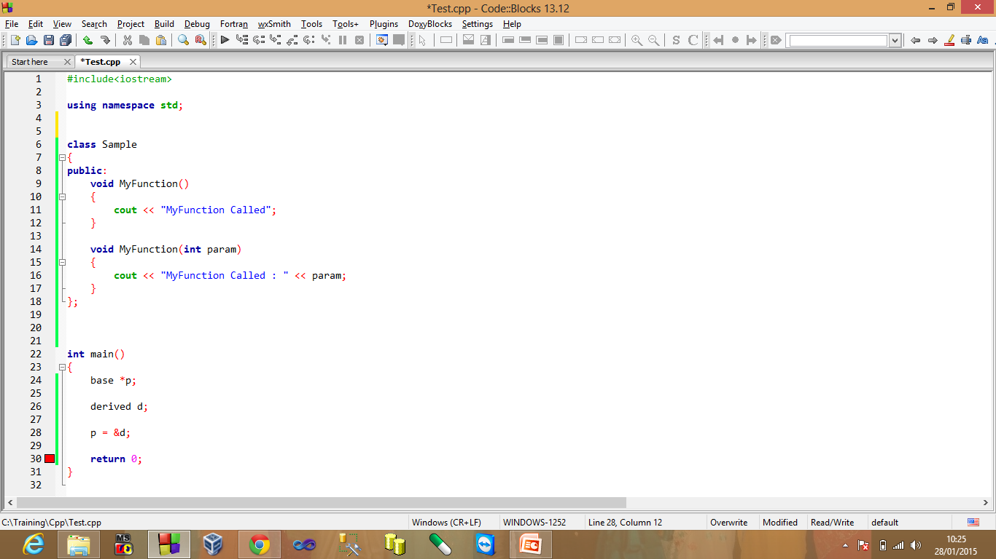
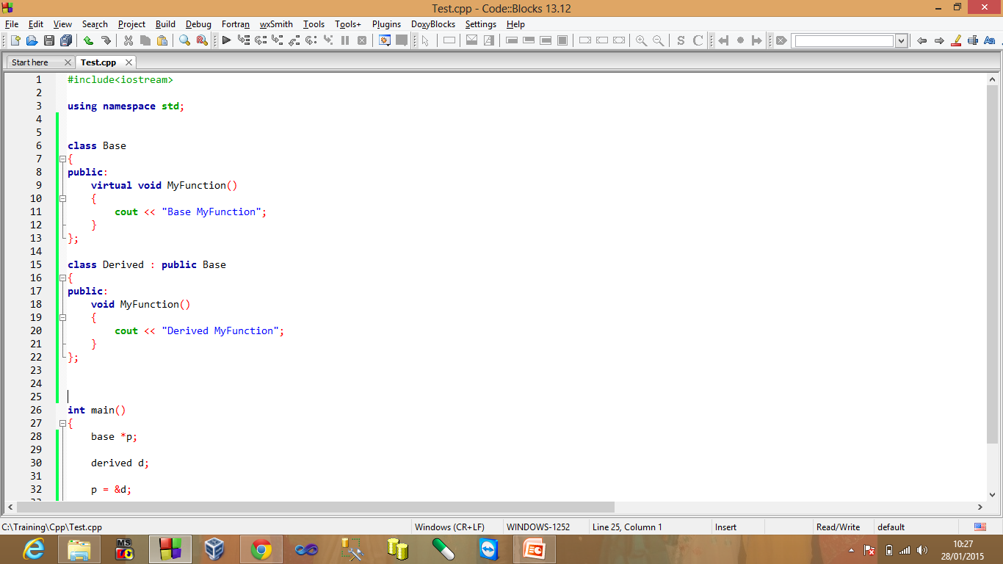
Method Overloading vs. Overriding?
 | Overloading | Overriding
Method Relationship | Relationship is between methods of same class. | Relationship is between methods of super class and sub class.
No of Classes | Does not require more than one class for overloading. | Requires at least 2 classes for overriding.
Example

Slide 29
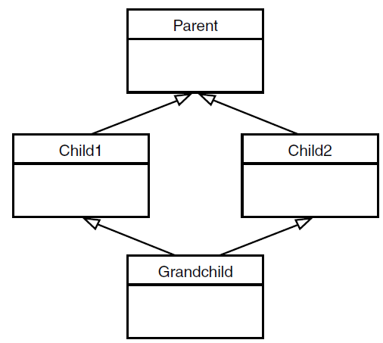
Virtual Base Classes
Multiple Inheritance

Slide 30
Virtual Base Classes
class Parent {
protected:
int basedata;
};
class Child1 : public parent {
  { };
class Child2 : public parent {
  { };
class GrandChild:
public Child1, public Child2
{ public:
  int getdata() { return basedata; } //ERROR
};

Slide 31
Virtual Base Classes
class Parent {
protected:
int basedata;
};
class Child1 : public parent {
  { };
class Child2 : public parent {
  { };
class GrandChild:
public Child1, public Child2
{
public:
  int getdata()
  { return basedata; } //ERROR
};
class Parent {
protected:
int basedata;
};
class Child1 : virtual public parent {
  { };
class Child2 : virtual public parent {
  { };
class GrandChild:
public Child1, public Child2
{
public:
  int getdata()
  { return basedata; } //OK
  };

